Slide 1
DESIGN & ANALYSIS OF ALGORITHM
PCC-CS501

Slide 2
Design & analysis of ALGORITHM Schedule ----topic wise
 | Topic | Sub Topic
1 | INTRODUCTION | Design of algorithm , Analysis of algorithm, Algorithm properties
2 | FRAMEWORK FOR ALGORITHM ANALYSIS | HOW TO COUNT EXECUTION TIME OF ALGORITHM,INPUT INSTANCES
3 | ASYMPTOTIC NOTATION | BEST CASE,AVERAGE CASE, WORST CASE
4 | SOLVING RECURRENCE RELATION | SUBSTITUTION METHOD, MASTER THEOREM
5 | ALGORITHM DESIGN TECHNIQUES | DIVIDE & CONQUER, GREEDY,DYNAMIC PROGRAMMING, BACKTRACKING,
6 | DISJOINT SET MANIPULATION | UNION FIND
7 | NETWORK FLOW PROBLEM | FORD FULKERSON ALGORITHM
8 | NP COMPLETENESS | NP,NP HARD………ALGORITHM
9 | APPROXIMATION ALGORITHM | COMPLEXITY ANALYSIS OF NP COMPETE PROBLEM

Slide 3
Practice Problem
Func1(n){ …………………T(n)
If(n>0)
{ O(?)
Func1(n-1)………………T(n-1)
write(“A”)………………1
Func1(n-1)……………….T(n-1)
} ………………….
T(n)=2T(n-1)+1
}

Slide 4
Solving using master theorem
It is a direct way to get the solution.
The master method works only for following type of recurrences or for recurrences that can be transformed to following type.
T(n)= a T(n/b) + f(n) where a >=1 and b >1

Slide 5
master theorem is applicable or not
T(n)= (2^n)T(n/2)+n
T (n) = 16T (n/4) + n
T (n) = 2T (n/4) + n ^{0.51}
T (n) = 0.5T (n/2) + 1/n
T (n) = 64T (n/8) − n 2 log n

Slide 6
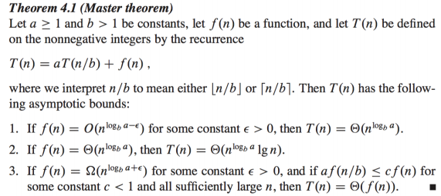
Master theorem

Slide 7
Master theorem example
Recurrence relation | a | b | Log_{b}a | n^{Log}_{b}ª | f(n) | rule | Ɵ()
T(n) = 9T(n/3)+n | 9 | 3 | 2 | n^2 | n | 1 | n^2
T(n) = T(2n/3)+1 | 1 | 3/2 | Log_{3/2}1 | n⁰ | 1 | 2 | Log n
T(n) = 3T(n/4) + n log n | 3 | 4 | Log₄3 | n^{0.793} | n log n | 3(n/4)log(n/4)<=c n log n, c=3/4 so rule 3 | nlogn
T(n) = 2T(n/2)+n log n | 2 | 2 | 1 | n | n log n | Not applicable | x

Slide 8
Observation Master theorem not applicable
1.It is possible for f(n) to be asymptotically larger than n^{Log}_{b}ª ,
but not larger by a polynomial factor
(no matter how small the exponent in the polynomial is).
For example, this is true when f(n) = n^{Log}_{b}ª log n
If recurrence relation is not following
T(n)= a T(n/b) + f(n) where a >=1 and b >1
Example: T(n)= T(n-1)+1

Slide 9
Observation master theorem
The problem size must shrink by a constant factor
The subproblems must all have the same size
There must be a constant number of subproblems
The additive term must be a polynomial.

Slide 10
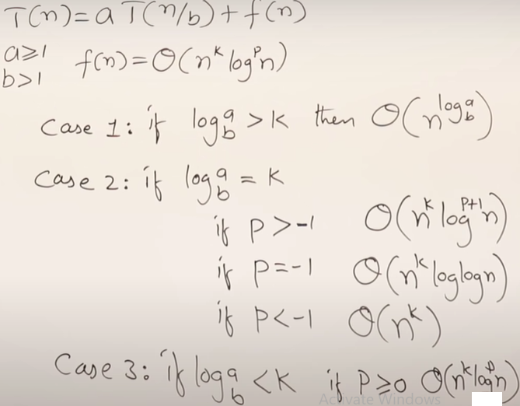

Master theorem
T(n)=T(n/2)+1
T(n)=4T(n/2)+n
T(n)=9T(n/3)+n
T(n)=8T(n/2)+n log n
T(n)=2T(n/2)+n log n
T(n)=4T(n/4)+ (n/ log n)
T(n)=2T(n/2)+(n/log^2 n)
T(n)=T(n/2)+n^2
T(n)=T(n/2)+(n^2) log n
T(n)=4T(n/2)+n^3
T(n)=T(n/2)+ (n^2)/log n

Slide 11
Next class
DIVIDE & CONQUER

